Slide 1

Advanced Security 2 - Assignment 1
By Omair Duadu
C18322011

Slide 2
There has been a sharp increase for the demand for cybersecurity specialists In our current modern age computer device are reaching all across our lives. These all create vulnerabilities, and the more devices we have in our life the more vulnerabilities there will be. Unfortunately there hasn’t been a reaction in the response by producing more specialist in this industry Recently however there is more specialists being trained and skilled. This will help shore up the insecurities that are present.
Part A

Slide 3
Downloaded Sonarlint and JShint which are both programs for testing and identifying security flaws in code. They both uncover any flaws the developer may not have noticed SonarLint pointed out 7 flaws/problems that may make my program less secure JShint on the other hand uncovered 41 flaws/problems in my program, however they were mainly coding preferences
Part B

Slide 4
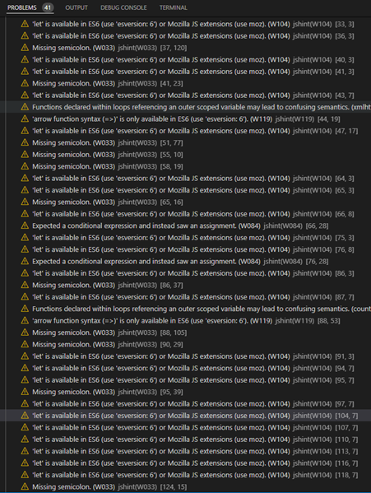
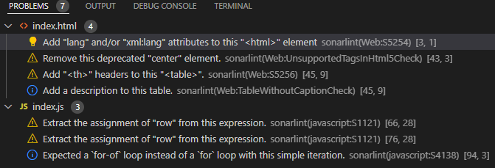

Slide 5

Google hacking involves using advanced operators and security mind in the Google search engine to locate specific strings of text within search results. Understanding these Google hacking methods and techniques is an important skill for the penetration tester.
Part C

Slide 6
Search Engines Example: Yahoo Advantage: Yahoo offers thorough organic results, and it has better shopping search features than other search engines. Disadvantage: undated search results, along with unclear labelling of ads which can make it difficult to know which results are ads and which are organic results. Baidu Advantages : offers amazing features and high-quality search results. Disadvantages : government censorship which leads to integrity questions of the search results
Part C

Slide 7
Vulnerabilities are weaknesses in the system design, implementation, software or code, or the lack of a mechanism. Vulnerabilities and weaknesses are common with software mainly because there isn't any perfect software or code in existence. Vulnerabilities in software can be found in : firmware, operating systems, configuration files, application software and patches. Exploits: Spyware, Viruses, Ransomware, Bots, Adware, Worms, Trojans, Ransomware, Logic Bombs, Rootkits.
Part D

